Slide 1
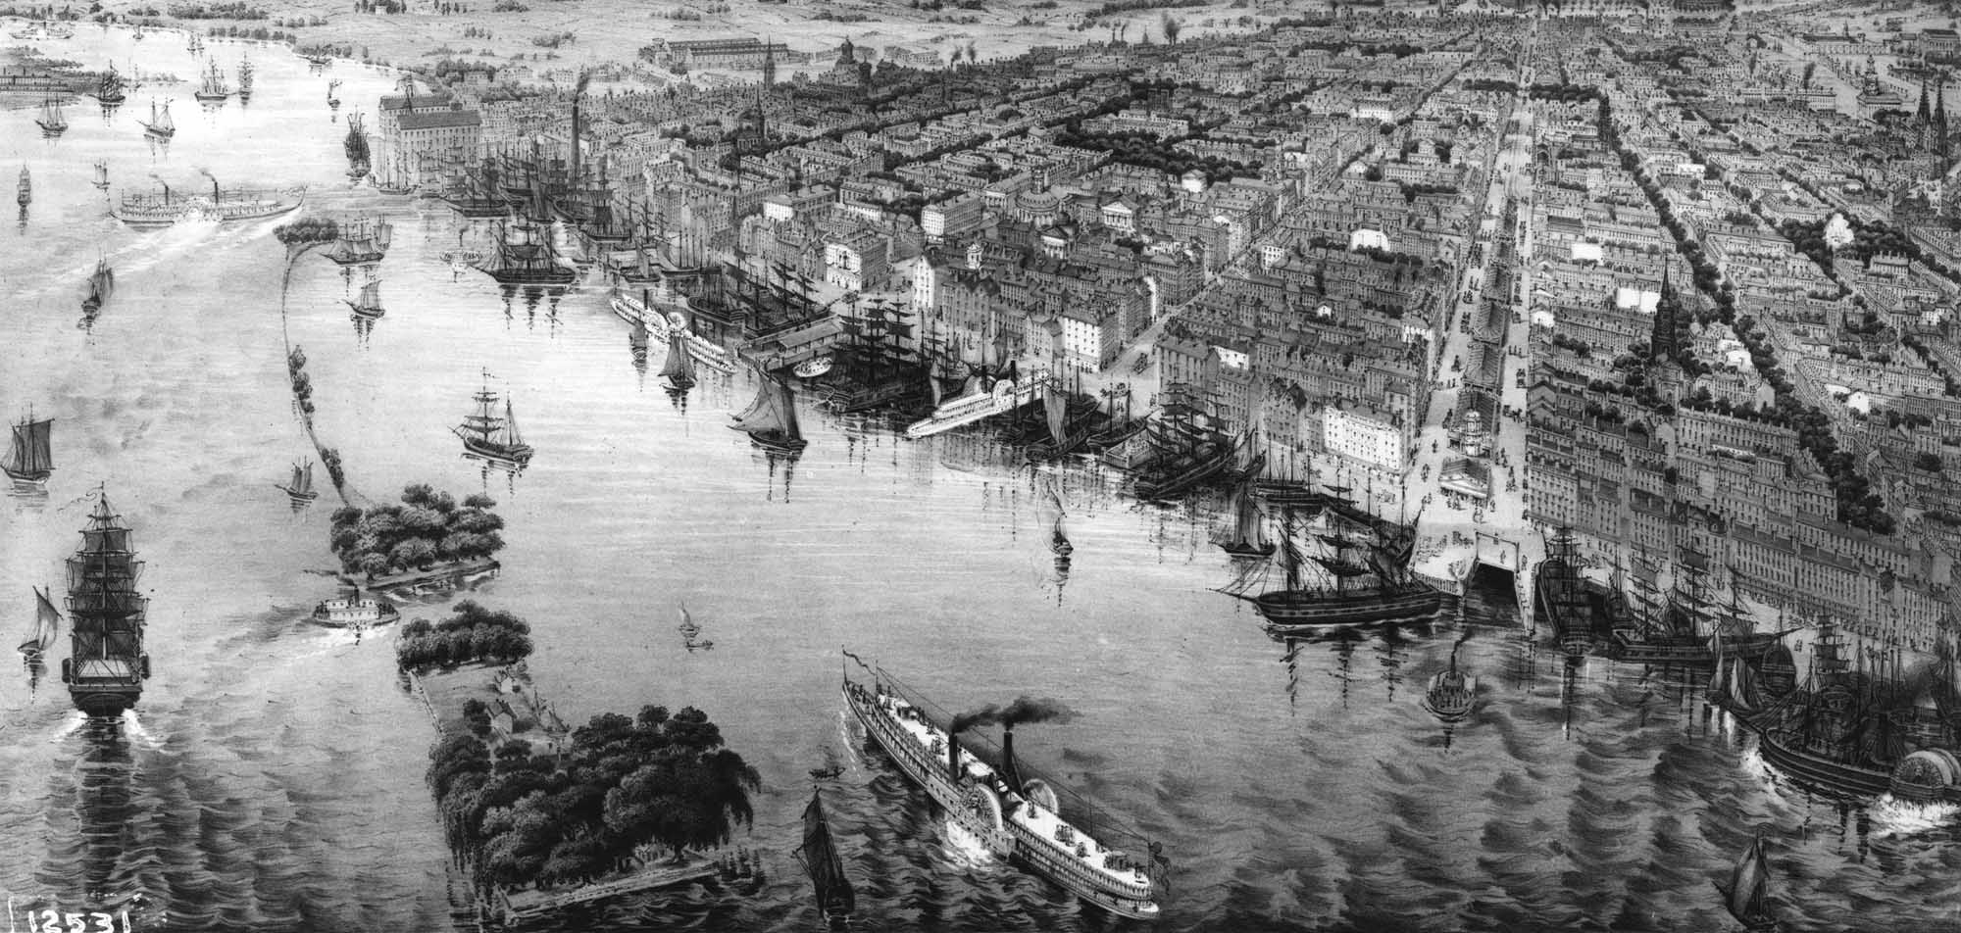
THE CENTER FOR APPLIED ECONOMICS - COMMUNITY SERIES Global Economics Panel
Unusual Tariffs and Their Unusual Stories
Stephen Dansky, Adjunct Professor of Economics
Indian River State College
November 7, 2018
The views expressed herein are the presenter’s and do not necessarily reflect
the views of Indian River State College, its faculty, or its staff.

Slide 2
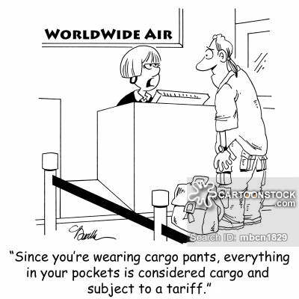

Slide 3
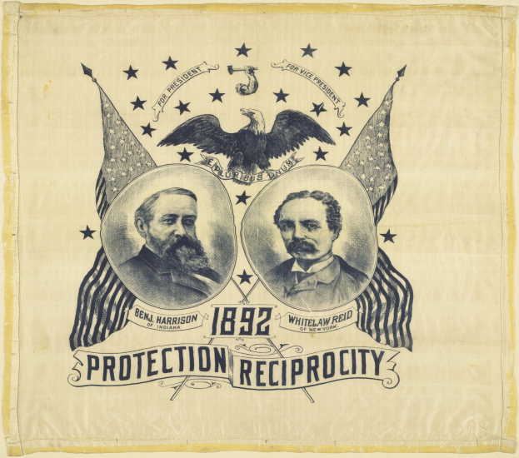
What is a Tariff?
A tariff is a tax on an imported item, usually applied as a percentage of the item’s import price.
Tariffs have been part of the US economy for a long time.
The second law signed by George Washington enacted a tariff of 5% on most imported items.
The stated purpose of that tariff was two-fold:
To protect fledgling US businesses, and
To raise revenue for the federal government (there was no income tax yet).
In 1792 these tariffs provided 95% of the federal government’s revenue.
Tariffs remained a significant part of the government’s revenue until the mid 1800s and has been steadily decreasing since.
In 2010 it was only 1.2%

Slide 4
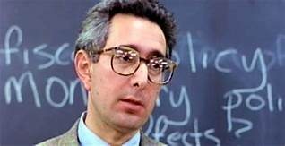
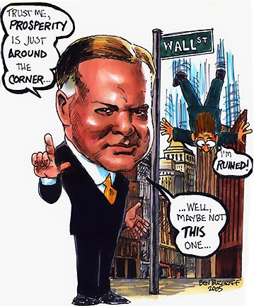
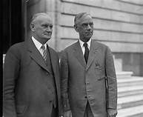
Perhaps the most controversial tariff was the 1930 Smoot-Hawley Tariff.
The tariff levied an import tax on thousands of items.
Raised U.S. tariffs to an all-time high
Most economists opposed
Foreign countries retaliated
Prolonged and worsened the Great Depression.
Up to and including the Smoot-Hawley Tariff, it was Congress’ authority to levy tariffs (just as it does other taxes).
The political fallout from the abysmal failure of Smoot-Hawley was so great that Congress ceded its tariff levying authority over to the President where it remains today.
Today, since tariffs comprise a small part of the government’s revenue, we find that the purpose of most tariffs is either punitive or protective, and not revenue generating.
Side Note: This is a scene from the 1986 movie “Ferris Bueller’s Day Off” where Ben Stein delivers a comedic lecture on the Smoot-Hawley Tariff.

Slide 5
How Do Tariffs Work?
What Does a Tariff Do?
The Economic Impact of Tariffs
Price
S
When there is no tariff, market equilibrium can be reached enabling consumer and producer surplus to be maximized
P
D
Q
Quantity

Slide 6
What Does a Tariff Do?
The Economic Impact of Tariffs
Case 1: The Impact on the Imported Items
Deadweight Loss is created equal to areas C and E
P
S₁
When there’s a tariff, the supply curve shifts up by the amount of the tariff (t)
S₀
A
Consumer surplus is reduced by the area B.
t
P₁
B
C
Producer surplus is reduced by the area D.
P₀
D
E
Government collects the tariff shown by areas B and D.
F
D
Q
Key Point:
Price goes up and the quantity produced/sold goes down.
Q₁
Q₀

Slide 7
What Does a Tariff Do?
The Economic Impact of Tariffs
Case 2: The Impact on the Domestic Items
P
Deadweight Loss is created equal to areas C and E
When there’s a tariff, the supply curve shifts up by the amount of the tariff (t)
S₁
S₀
A
Consumer surplus is reduced by the area B.
t
P₁
B
C
Producer surplus is increased by the area B.
P₀
D
E
No tariff is collected by the government.
F
D
Q
Key Point:
Price goes up and the quantity produced/sold goes down.
Q₁
Q₀

Slide 8
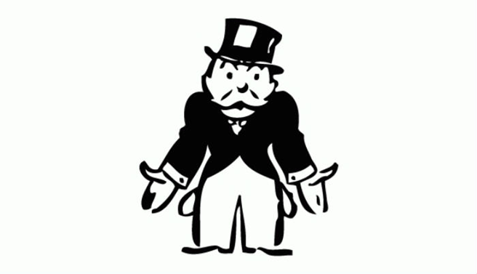
Key Point:
Price goes up and the quantity produced/sold goes down.
So…when we ask the question per the theme of tonight’s seminar
“Tariffs and Trade: What’s the Impact on the U.S. Economy?”,
the general answer is
the consumer is forced to pay more,
so the consumer now has less money to spend on other items,
which causes the consumer’s standard of living to go down,
And
because the price is higher,
then the quantity produced goes down,
which causes employment to go down.

Slide 9
Law of Unintended Consequences Like all taxes, tariffs can lead to unintended consequences
The “Law of Unintended Consequences” refers to how economic decisions can have effects that are unexpected.
Usually, this refers to an economic action (such as higher prices from a tax or tariff) that distorts consumer or producer behavior in a way that is unexpected.
Sometimes, on the surface, this behavior can seem unusual.

Slide 10
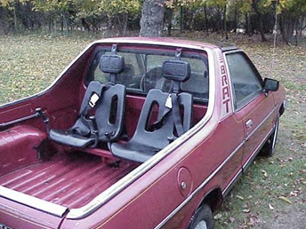
For example,
a tariff on the exporting of these…
…led to the importing of these!

Slide 11
The Unusual Story of the Chicken Tax
After WWII chicken and other meats were very expensive in Germany, but chicken became much less expensive in the US due to new farming methods.
Because of the lower price, German consumers began importing large quantities of frozen chicken parts from the US.
German chicken farmers protested and the German government placed a high tariff on frozen chicken parts.
In economic circles this has become known, infamously, as “The Chicken Tax”).

Slide 12
Meanwhile:
The UAW was threatening a labor strike in a presidential election year (1964), and
The US was importing growing quantities of low cost German cars (such as the VW Beetle) and German auto makers were planning to begin exporting low cost pickup trucks to the US.
President Lyndon Johnson saw a two-fold opportunity.
He could retaliate against the German chicken tax and he could mollify the UAW by placing a tariff on imported pickup trucks.
As such, it was both a punitive and a protective tariff.
The UAW agreed not to strike, which helped Johnson’s re-election.

Slide 13
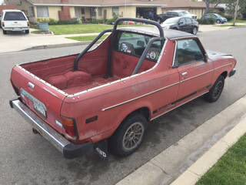
Today, 54 years later, the tariff on imported pickup trucks is still in place.
Many foreign automakers have made use of various “workarounds”.
The most unusual is the Subaru Brat.
By installing inexpensive plastic seats in the flatbed, it qualified as a passenger car which has a lower tariff (2.5% vs. 25%).
Once in the US, the seats were removed.

Slide 14
The Unusual Story of the Santa Suit
Is a Santa suit a “festive item” or is it “clothing”?
This question was the subject of a recent federal court case between the US government and an importer of Santa suits.
The government argued that Santa suits are clothing, which is subject to a 30% import tariff under US tariff regulations. (The “Harmonized Tariff Schedule of the US”).
The importer claimed it’s a festive item, which is not subject to an import tariff under the Harmonized Tariff Schedule of the US.

Slide 15
So, Which Is It?
The Harmonized Tariff Schedule of the US has about 10,000 listings but does not have a listing for Santa suits.
The court ruled that the quality of the Santa suit determines its category. If it uses Velcro closures it’s likely to be considered a festive item, but if it uses zippers it’s likely to be considered an article of clothing.
The unintended consequence of the court ruling is that more Santa suits imported into the US will now be made with Velcro closures.

Slide 16
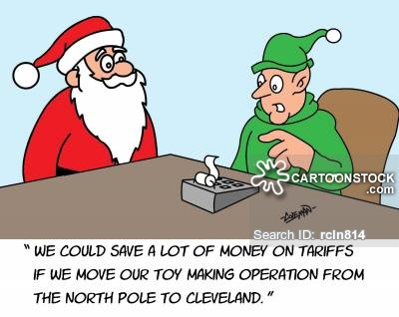
Law of Unintended Consequences: If Santa moves his operation to Cleveland, the US Postal Service will need to expand its Cleveland office.

Slide 17
Example of an Unusual Punitive Tariff
* France refused to participate when the US invaded Iraq in 2003.
They didn’t even allow our military planes to fly in French airspace which would have saved jet fuel. * The Bush Administration “punished” France with a 300% tariff on Roquefort cheese.
--This would cause the price to jump between $60-100 per lb. --The higher price would, in turn, reduce the quantity of Roquefort cheese sold in the US. * The tariff was clearly punitive, and not protective, since no Roquefort cheese is made in the US. * This punitive tariff was removed when Obama took office.
Side Note: The Congressional dining room changed its menu from French Fries to Freedom Fries.

Slide 18
Two Very Recent Punitive Tariffs That, On The Surface Seem Unusual, Are Clearly Political
In response to some of the recent Trump tariffs, the EU retaliated with several seemingly unusual punitive tariffs, including tariffs on bourbon whiskey and orange juice.
Of all the items we export to Europe, why these two?
On closer inspection, we see the EU’s intent is to have maximum political effect.
Bourbon whiskey comes from Kentucky, which is Senate majority leader Mitch McConnell's state.
Orange juice is a major export of Florida, which is a key US swing state important to Trump’s election.

Slide 19
Example of an Unusual Protectionist Tariff
The Story of the Paper Clip
Two US companies make paper clips (ACCO and Officemate). ACCO dominates the market by far.
Much of ACCO’s equipment is over 50 years old and inefficient.
Chinese companies have newer more efficient machinery and in the 1990s began selling paper clips in the US.
Since 1994 tariffs up to 127% have protected ACCO and Officemate from Chinese competition.

Slide 20
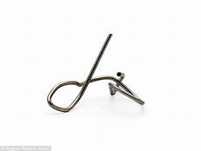
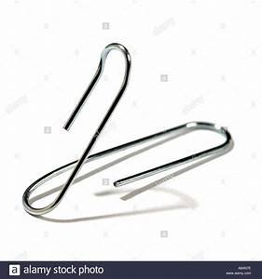
So What’s Unusual Here?
According to the Department of Commerce, their original and subsequent rulings are based on the testimony submitted by “all interested parties”, which to date, has only been ACCO.
In 2017 the Department of Commerce recommended renewing this tariff for another five years citing “material injury to an industry in the United States” despite no claim of an impact on national security or loss of a significant number of jobs.

Slide 21
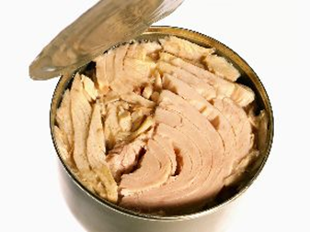
Example of a Tariff Designed to Favor One US Company Over Another An Unusual Fish Story

Slide 22
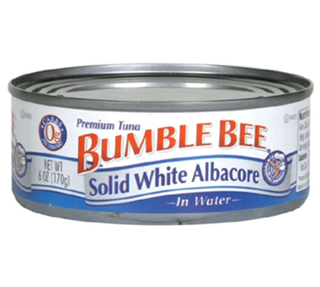
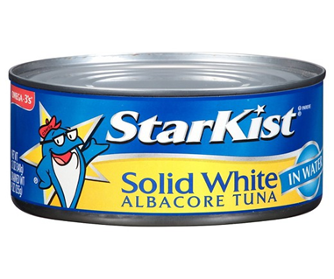
At the time of this story, Bumble Bee was a subsidiary of a US company (ConAgra Foods) and StarKist was also a subsidiary of a US company (HJ Heinz).
Bumble Bee imported the raw tuna into the US and performed its canning in the US.
StarKist did its canning outside the US and imported the final canned product into the US.
In 2002, to disadvantage its competitor, Bumble Bee was able to get a 35% tariff imposed on imported canned tuna.
(Something very fishy going on here!)

Slide 23
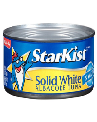
But the Chess Game Continues…
As a counter move, StarKist moved its canning operation to American Samoa to avoid the tariff.
As a counter-counter move, Bumble Bee was able to get Congress to increase the minimum wage in American Samoa, thereby increasing StarKist’s costs.

Slide 24
I’m Still Puzzled By This Unusual Tariff (because its neither protective or punitive)
* This year Trump placed a 25% tariff on Chinese antiques.
* Since antiques were made a long time ago, the importation of these antiques is not displacing current US manufacturing jobs, so it’s not a protective tariff.
* Nor is it affecting current Chinese manufacturing jobs because the antiques were made a long time ago, so its not a punitive tariff either.
* Moreover, it’s very narrowly targeted and won’t affect that many transactions. The likely consequence is that more Chinese antiques will wind up in European museums and less in American museums.

Slide 25
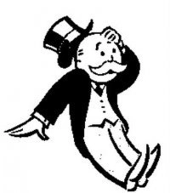
Summary
Some tariffs are punitive
Ex: Roquefort cheese
Some tariffs are protective
Ex: Paper clips
Some tariffs are both punitive and protective
Ex: “The Chicken Tax”
Some tariffs are strategic gamesmanship of one US company against another
Ex: Canned Tuna
Some tariffs are simply puzzling (probably because there’s more to the story)
Ex: Chinese antiques
But in all cases, the US consumer pays more.

