Slide 1
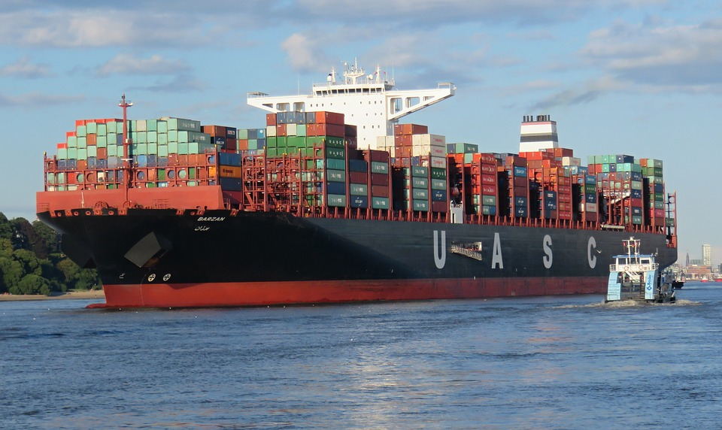
Will the Global Supply Chain Survive the Tariff War?
Lee A. Bertman, MSc, MA, CPA
Adjunct Professor, Economics

Slide 2
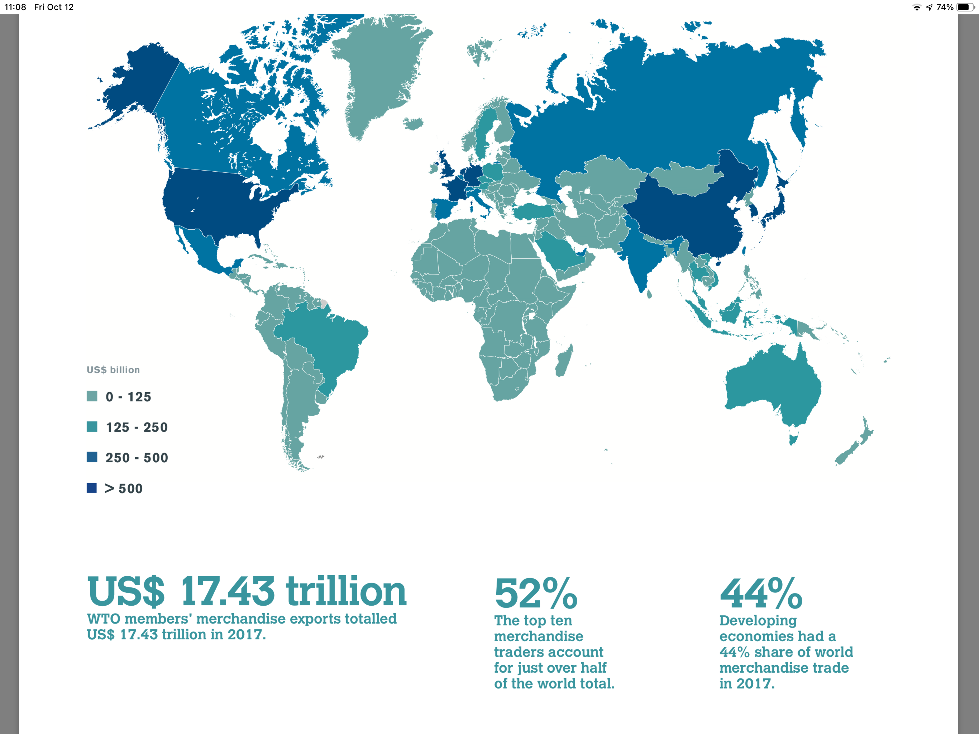
Volume of International Trade
Merchandise trade in 2017 totaled $17.73 trillion.
Services trade totaled $5.28 trillion.
So total World Trade of $23.01 trillion actually exceeded
US Gross Domestic Product (GDP) of $19.39 trillion.
Notes:
So trade accounts for about 29% of the $80 trillion world economy.

Slide 3
ll

Slide 4
Very Large Container Ships Move 90% of World Merchandise
The “Madrid Maersk” carries 20,000 containers. The ship weighs 214,283 gross tonnage. It measures 1,309 feet length by 192 feet beam.
Notes:
This saves shipping time by 84% and reduces shipping costs by 35%. It reduces theft and damage and permit containerized goods to move from factory origin to local destination without repeated handling.

Slide 5
What is Trade?
A “trade” is simply a transaction, an exchange, between two parties: persons, firms or government. The exchange is for a good or service.
Trades usually involve “money” as the medium of exchange.
When I use money to purchase gasoline I am trading my services as an instructor for gasoline using the convenience of money (So I don’t need to find a gas station owner who needs instruction in economics)!
In our economy there are likely millions (maybe billions) of transactions/trades every day.
Trade occurs among our countries, states and territories and with countries outside our boundaries (which is called “international trade”).
What differentiates international trade for domestic trade: Different currencies, transportation costs, tariffs and non-tariff regulations.

Slide 6
Why Trade?
We need raw materials and commodities not available (or in short supply) domestically.
Specialization in products: There are literally tens of thousands goods and services produced and consumed. Even an economy as large as our doesn’t make every good or service that we consume.
Specialization in production: Economies of scale. Some production processes, such as civil airline production, require very large production facilities. Production of products requires
Comparative advantage: Emerging economies have comparatively low labor costs so labor intensive products are produced there. (Minimize cost per unit of production).
Global supply chain: A significant portion of US imports is for components for US manufactured products. Almost every good or service in the US has inputs from other countries. Our goods and service are a composite of domestic and international trade.

Slide 7
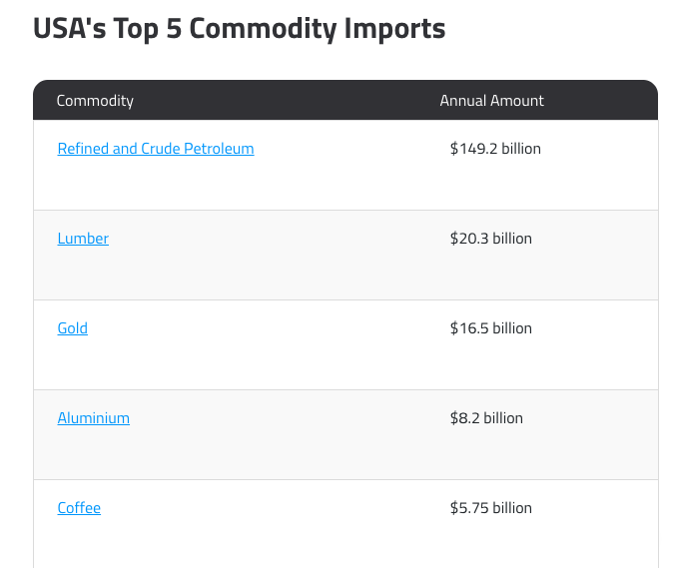
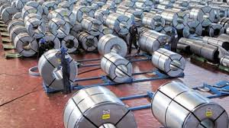
What Do We buy From Overseas?
Commodities:

Slide 8
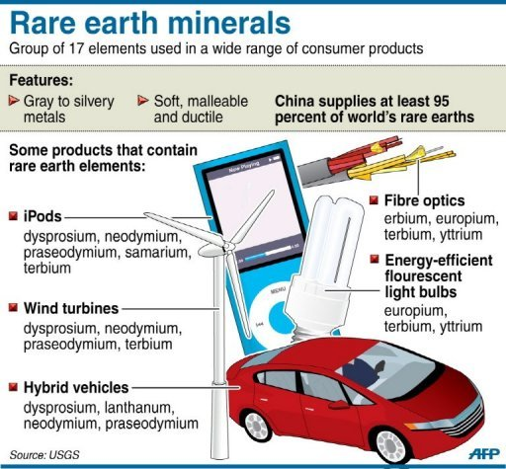
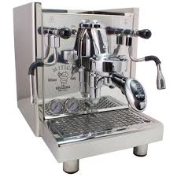
What Goods and Inputs Do We Buy from Overseas?
We import products we don’t produce here.

Slide 9
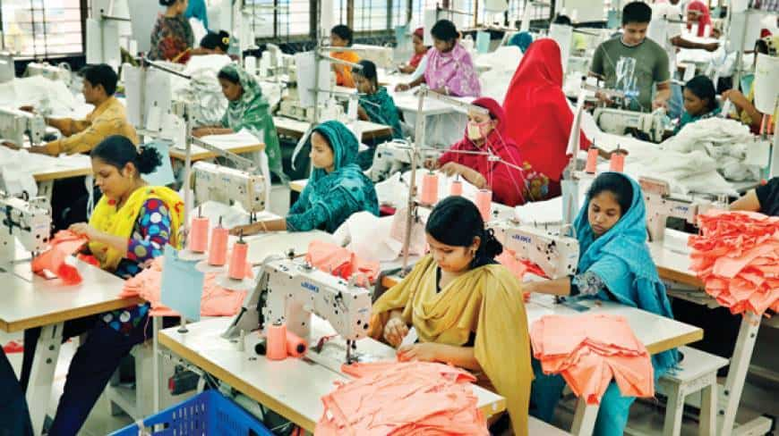
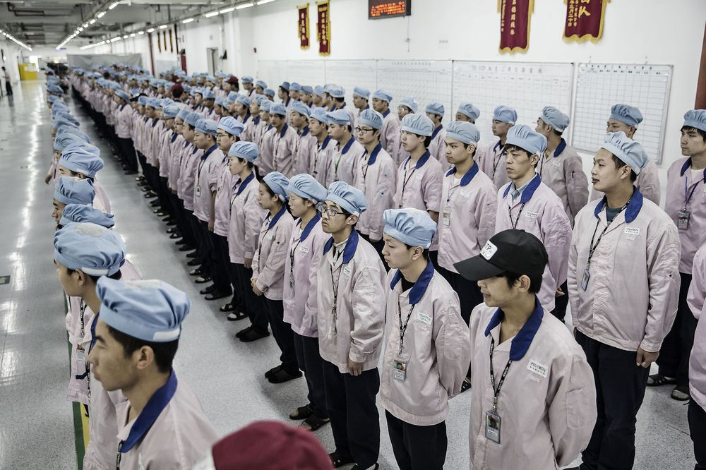
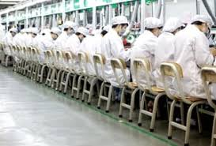
Why Do We Buy From Overseas?
Because those imports are less expensive. We might be more efficient but wages overseas are much lower. So our workers specialize in better paying, higher skilled jobs.
Bangladesh employs 3.6 million workers
for less than $1.00 per hour.
Foxconn workers earn $580 per month or
about $3.60 per hour. Foxconn hires 7,000
new workers each year.

Slide 10
Trade has Led the US to Become the World’s Leading Economy
The success of the US economy is due, in large part, to our being the largest free trade zone in the world. We have free movement of goods, services, labor and capital with a (mostly) uniform legal system and a common language, English.
Tariff free trade is the law among our States and territories. Free trade is protected by the Constitution of the United States through interpretations of the Commerce Clause.
US GDP in 2017 was $19.39 trillion. The next largest free trade zone is the European Union with an $18.8 trillion economy. But the EU has 24 official languages and many different legal systems, being a union of 28 member states. The Euro is the unified currency. The Euro is used by 19 of the 28 members.
China’s GDP was $12.24 trillion in 2017. China has eight different language groups though the official language is Mandarin. There is no free movement of workers and persons within China. Internal passports and governmental approvals are required. China uses a common currency the Yuan.

Slide 11
The United States has a Growing Trade Deficit
The trade deficit grew to $566 billion in 2017 the largest deficit to date.
The deficit with China grew 8% to $372.5 billion.
About one third of the deficit with China was “consumer electronics, computer and cell phones.”
The administration has applied tariffs in an effort to reduce the trade deficit and bring production back to the US.
Major concerns with Chinese policy are alleged theft of intellectual property and unfair trade practices such as requiring US companies in China to partner with Chinese companies and thereby transfer trade secrets to their partners.

Slide 12
What are Tariffs?
A tariff is like a sales tax charged by the Federal Government on specific imported goods.
Application of tariffs is very complicated. The latest edition of “The Harmonized Tariff Schedule of the United States” runs 3,713 pages so there are many thousands of categories, which are very specific.
For example the duty on artificial flowers differs whether made from plastic (8.4%), feathers (4.7%) or man-made fibers (9%)!
So importers and exporters have plenty of incentive to classify
imports to lower duties. And much of this doesn’t make much
sense.

Slide 13
What’s Wrong with Tariffs? (Let Me Count the Ways)
Countries need to export what they can produce at the lowest cost and import goods and services which can be imported at the lowest cost.
International and domestic trade are pretty much the same in principle. We specialize in producing what we can most efficiently (lowest cost) and buy goods and services from other efficient producers. That is we “specialize” in what we do best.
What about low wage countries? Is that “unfair” trade? No, the wages are low due to poor productivity. Products such as clothes are imported because wages are low and so is productivity.
But there is an “hidden” problem with tariffs. About 50% of imports from China are inputs to US production. So those tariffs actually make the US manufacturers less competitive.

Slide 14
A Mistaken Belief
Implicit in making policy on trade and tariffs is the notion that we are dealing only in “Final Goods.”
But that’s not the best way to view the economics of trade.
Rather the concept of “Value Added” in far more relevant. Almost all goods and services are part of the “Global Supply Chain.”
For example for US exports about 88.7% is US value added while 11.3% is an reexport of imported components.
For imports 25.1% is an import of US value added components while 74.9% is actual foreign value added.
The next chart shows the importance of looking at trade on a value added basis.

Slide 15
Tariffs on Final and Intermediate Goods
A tariff is like a sales tax charged by the Federal Government for an imported product when it arrives in the US.
The average US tariff is 3.5%. The world average tariff is about 10%. China’s average tariff is 10%.
The US has imposed tariffs of 10% rising to 25% on about $250 million of Chinese imports – about 50% of imports in total. China has threatened to retaliate.
These tariffs will have a major impact on US manufacturing costs since many of “components” are made in China. “Intermediate goods” account for about one half of Chinese imports. “Intermediate goods” are used as components or inputs for US manufactured goods.
So the tax on Chinese “intermediate goods” will cost US manufacturers another $31.25 billion in higher production costs.

Slide 16
US Exports & Imports as Value Added

Slide 17
Boeing 787 Made in the World

Slide 18
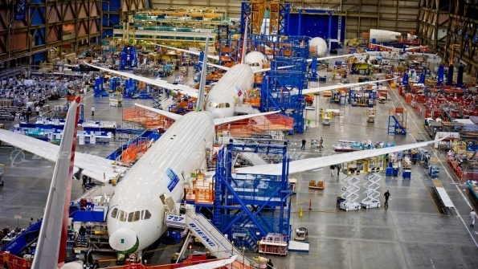
Manufacturing a Boeing 787 A Worldwide Effort
Design
Production
Assembly
Testing
Flight testing
Certification
Support
The effort to produce large commercial aircraft is so challenging that there are only two companies in the world: Boeing and Airbus. But they depend on thousands of suppliers for raw materials, services and components.

Slide 19
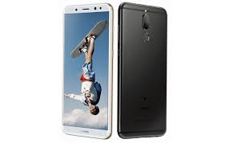
The iPhone Made in the World
Design is mostly from the US.
Assembly is in China and adds about $12 per phone.
Components are sourced from the US, South Korea, Japan, Taiwan, France, Italy, the Netherlands and Singapore among others.
Sales and service provided worldwide.
The iPhone is part of the global supply (or value) chain. It is an example of specialization and economies of scale. Apple even purchases certain displays from its chief competitor, Samsung.
To interrupt the Global Supply Chain is to halt production. US tariff and other barriers work to the advantage of its chief competitor, Samsung, and rising Chinese smart phone manufacturers Huawei, Xiaomi, Oppo, etc.
Huawei surpassed Apple in the number of smartphones shipped worldwide for the first time second quarter 2018!

Slide 20
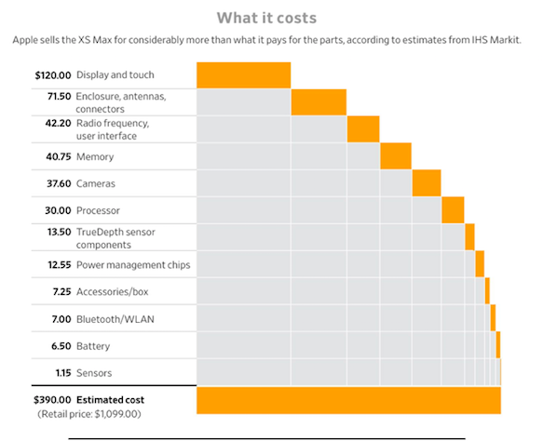
Value Added for the iPhone

Slide 21
Sources of iPhone Components

Slide 22
Is the Tariff War a Threat to US and World Prosperity?
Certain tariffs seriously harm the competitiveness of US manufacturers as they pay more for the components they need to make finished products. This is, in effect, a $31 billion tax on certain US manufacturers. Overseas competitors won’t be burdened by this tax.
Consumers are harmed by higher prices due to the cost of the tariffs, much of which we be passed on as higher prices.
The complex and critical Global Supply Chain is interrupted by the uncertainty of tariff policy: application and retaliation.
Issue with international trade need to be addressed with an understanding of the nature and importance of international trade and the Global Supply Chain.
Developing economies and our allies can be adversely affected leading to serious unintended consequences.

Slide 23
World Trade = World Prosperity
Between 1990 and 2017 world wide Gross Domestic Product rose from $23.4 trillion to $80.1 trillion. (3.42x)
Trade in goods was $3.496 in 1990 vs. $19.001 trillion in 2014.
(5.44x). So trade grew at 1.6x the rate of world GPD.
In large measure this was due to world trade which grew even faster than world GDP.
More than one billion people escaped poverty and infant mortality rates dropped by more than 50%.
During this time-frame the United States dominated the international arena and mostly set the rules of globalization and international trade.
We are at a critical turning point with China, Russia and Iran challenging US dominance. How will this end?
The trade tensions with China are critical because they involve the two large world economies having technological, trade and geopolitical competition.

