Slide 1
China And Russia retaliate against new us tariffs: This Is what you need to know
Dr. Larisa Ray

Slide 2
Introduction
Even though the US economy is strongly growing right now, households, businesses, and foreign investors become worried about new US tariffs. Usually, tariffs are a good tool to protect domestic industries against foreign competition. However, recently the US government started using tariffs as political tolls of a new foreign policy. In January 2018, the US imposed the tariff on solar panel imports from China. In July 2018, the US government-imposed tariffs affected more than 800 Chinese goods such as industrial machinery, medical devices and auto parts. Immediately, China accused the US of starting "the biggest trade war in economic history“ and responded with similarly sized tariffs on U.S. goods and services. In August 2018, Russian government also accused the US of declaring a trade war against Russia and responded with imposing its own tariffs on US goods. Also, both countries have applied to the World Trade Organization (WTO) to challenge the US tariffs on steel and aluminum. The US administration argues the rationality of this new trade policy was a necessary prevention of “unfair trade practices”, stealing intellectual property and forcing American companies to transfer American technologies to China. Tensions between the US and other countries like China and Russia are escalating which is raising the chances that this trade war could turn into a collapse of the US dollar and a new recession.

Slide 3
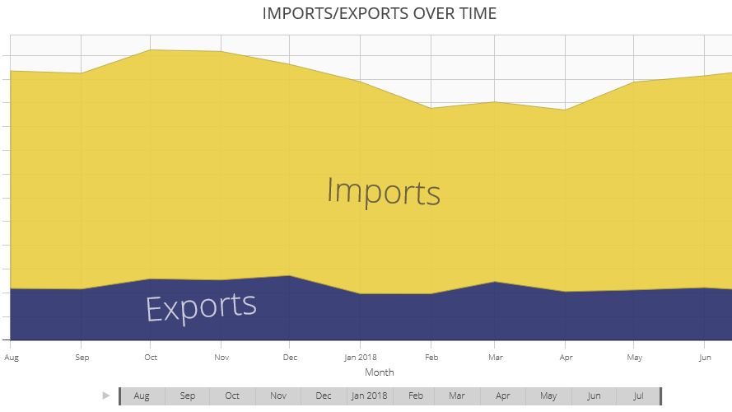
Us-China trade facts: Will China’s Trade Surplus decrease in 2018?
The answer is most likely NO. Here is why…
According to U.S. Census Bureau data analyzed by WorldCity, in July 2018, China ranked No. 1 among the United States’ top trade partners. In the same period in 2017, China was ranked No. 2.
In August 2018, China’s trade surplus with the US was $31.05 billion, up from $28.09 billion in July 2018.
Since January 2018, the Chinese export market has risen nearly 15 percent. At the same time, Chinese imports from the US grew only 2.7 percent in August 2018, compare with 11.1 percent in July 2018.
The top five U.S. exports to China by value through July 2018 were the categories of Civilian aircraft, parts; Oil; Motor vehicles for transporting people; Computer chips; and Soybeans, respectively.
The value of the top five categories of U.S. imports from China –– Cell Phones, Related Equipment; Computers; Computer Parts; Furniture, Parts; and Seats, excluding barber, dental –– accounted for 30.32 percent of all inbound shipments.

Slide 4
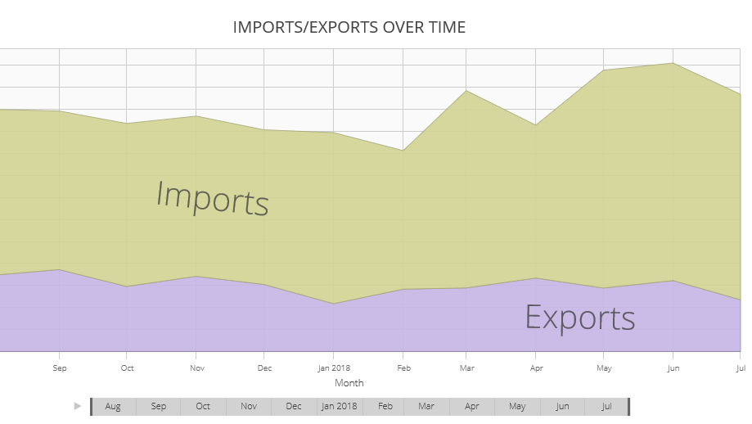
Us-Russia trade facts: Will Russia’s Trade Surplus decrease in 2018?
The answer is again NO. And here is why…
According to U.S. Census Bureau data analyzed by WorldCity, in July 2018, Russia ranked No. 28 among the United States’ top trade partners. In the same period in 2017, Russia was ranked No. 31. Through the first eight months of 2018, Russia’s trade with the US rose to $18.25 billion. In August 2018, Russian trade surplus increased more than 17 percent compared with the same time period in 2017.
In 2017, U.S. exports to Russia were $ 6.99 billion and imports from Russia were $17 billion. The U.S. deficit with Russia was $10.02 billion.
The top five U.S. exports to Russia by value through July 2018 were the categories of Civilian aircraft, parts; Motor vehicles for transporting people; Motor vehicle parts; Miscellaneous machines, parts; and Tractors, respectively. They accounted for 37.85 percent of total exports to Russia.
The value of the top five categories of U.S. imports from Russia –– Gasoline, other fuels; Oil; Pig iron; Unwrought platinum in various forms; and Aluminum, unwrought –– accounted for 66.66 percent of all inbound shipments.

Slide 5
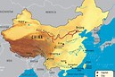
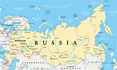
US Trade Deficit With China and Russia: Why is it so High?
There are three good reasons why:
1. a lower standard of living and lower wages compared to the US economy;
2. a greater the US demand for Chinese goods and Russian oil than Chinese and Russian demand for the US made goods and services;
3. the exchange rate and the foreign exchange reserves.
Here is how it works in China. Chinese government can directly affect the US dollar value to yuan. Once Chinese companies receive dollars from its exports to the United States, then they deposit the dollars into banks in exchange for yuan. Chinese commercial banks then send the dollars to the central bank: People's Bank of China which stockpiles US dollars in foreign exchange reserves.
Similarly, Russia is attempting undercut the domination of the U.S. dollar as the international reserve currency. Most of Russia’s export contracts in the oil and gas markets are still priced in dollars. The Russian government is planning to completely dump the US dollar in a relatively short period of time – in three to five years.
Russia already uses local currencies in trade with China and Iran.

Slide 6
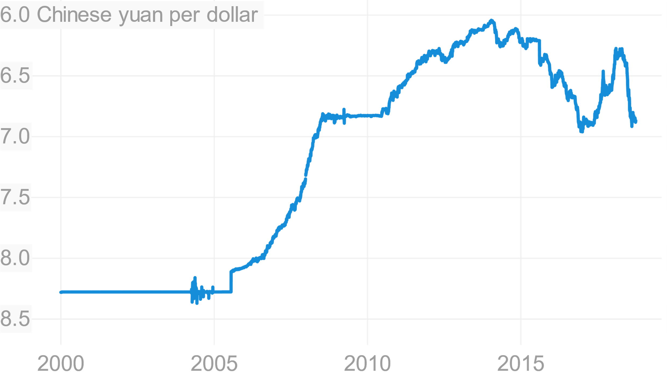
China Controls the value of its Currency
To keep the yuan artificially weaker against the dollar, the People’s Bank of China (the Central bank) has to trade yuan for US dollars by buying the US assets.
The reason is the trade surplus with America. According to the Office of the U.S. Trade Representative, only in 2017, the total surplus for China was $375 billion.
This means that Chinese firms-exporters, with an excess of U.S. dollars, must convert the US dollars to Yuan to pay their bills locally. As a result, these dollars end up with the People’s Bank of China, which provides the yuan to the local banks.
Then, the People’s Bank of China basically has only two choices: choice one is to keep these excess US dollars as a reserve and earn nothing, and choice two is to buy US treasuries and earn interest: a billions of US dollars. Additionally, with a second choice, keeping yuan artificially low helps Chinese firms-exporters.

Slide 7
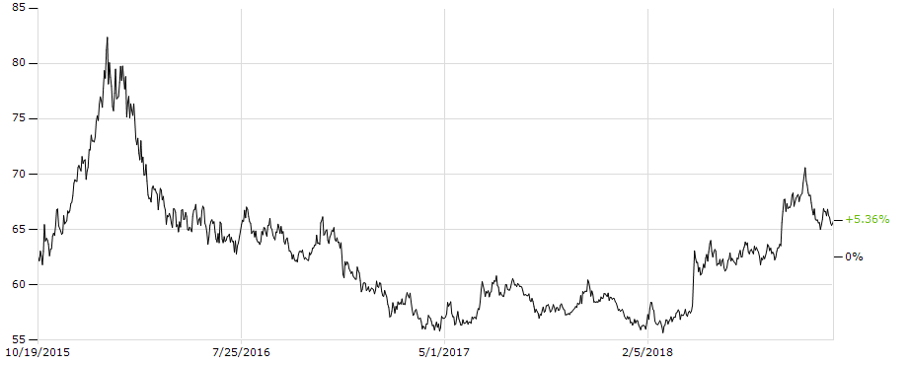
Is Russian Currency Declining in unison with the Chinese to debase the dollar?
Yes, it is. However, reasons why it’s happing are completely different…
The first reason is that the ruble exchange rate and world price of oil have a direct relationship: when oil price drops, Russian currency drops greatly. It happens because more than 60% of Russian exports are oil and gas. The most devastating effect of oil price drop was in 2014 when Russian currency declined in value by 59%.
The second reason of the ruble's decline is the economic sanctions resulting from the Ukrainian Crisis. For example, only the talk of the possibilities of increasing these sanctions, in August 2018, has resulted in a quick devaluation of the ruble by more than 5% to 69 rubles to one dollar.

Slide 8
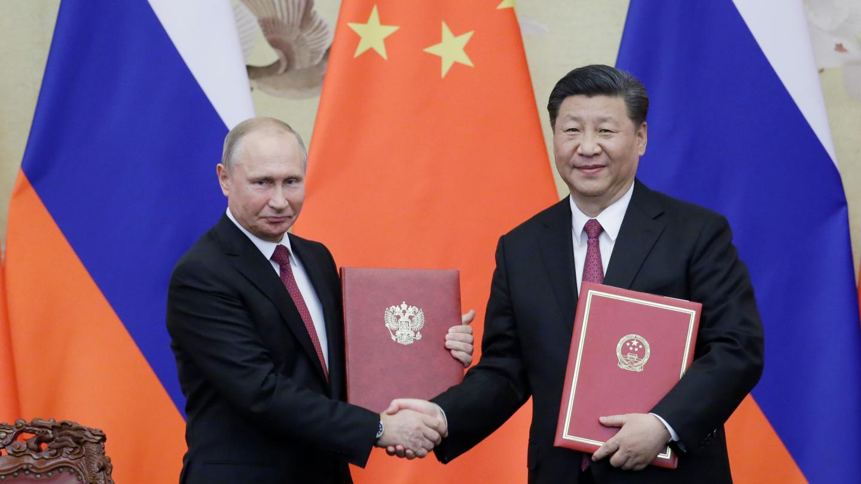
Will Russia Take China's Side Against U.S. in World Trade War?
Yes, it will. It’s already prepared.
After the US government imposed a new tariff on $200 billion worth of Chinese goods, China is already suing the US in the World Trade Organization (WTO) for $3 billion. Currently, the US and China appear rapidly headed toward open trade war, and Russia is prepared to side with China in this war. According to Russian newspaper Kommersant, Russia’s economic development minister, Maxim Oreshkin said: "Due to the fact that the U.S. continues to apply protective measures in the form of additional import duties on steel and aluminum and refuses to provide compensation for Russia's losses, Russia is using its WTO rights and introducing balancing measures with respect to its imports...”

Slide 9
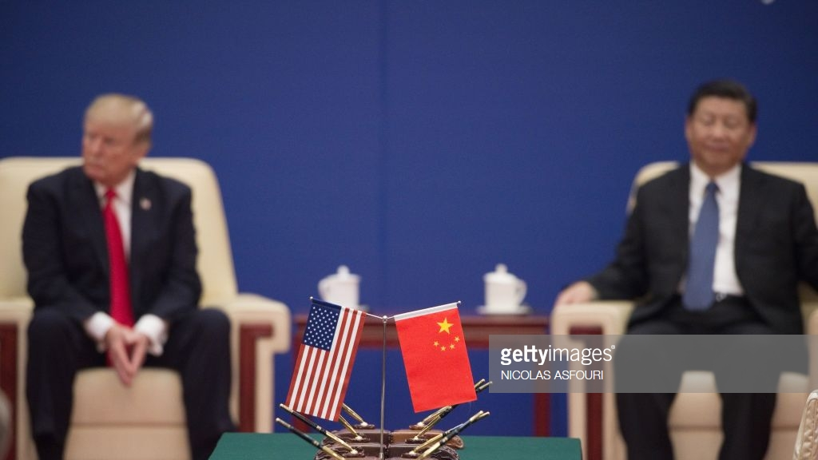
Does China have “a nuclear option” against the US?
Clearly, it’s very difficult to know how China, Russia and the US will play in this trade war game, but what we do know is that this trade war will have a profound impact on the future of the world economy. Right now, we cannot predict this trade war will be a zero-sum game or even a lose-lose game for both sides.
Currently, the US is acting as an aggressive and offensive player, while China and Russia are playing defense.
However, we do need to know that China does have a real “nuclear option” : US Treasuries.

Slide 10
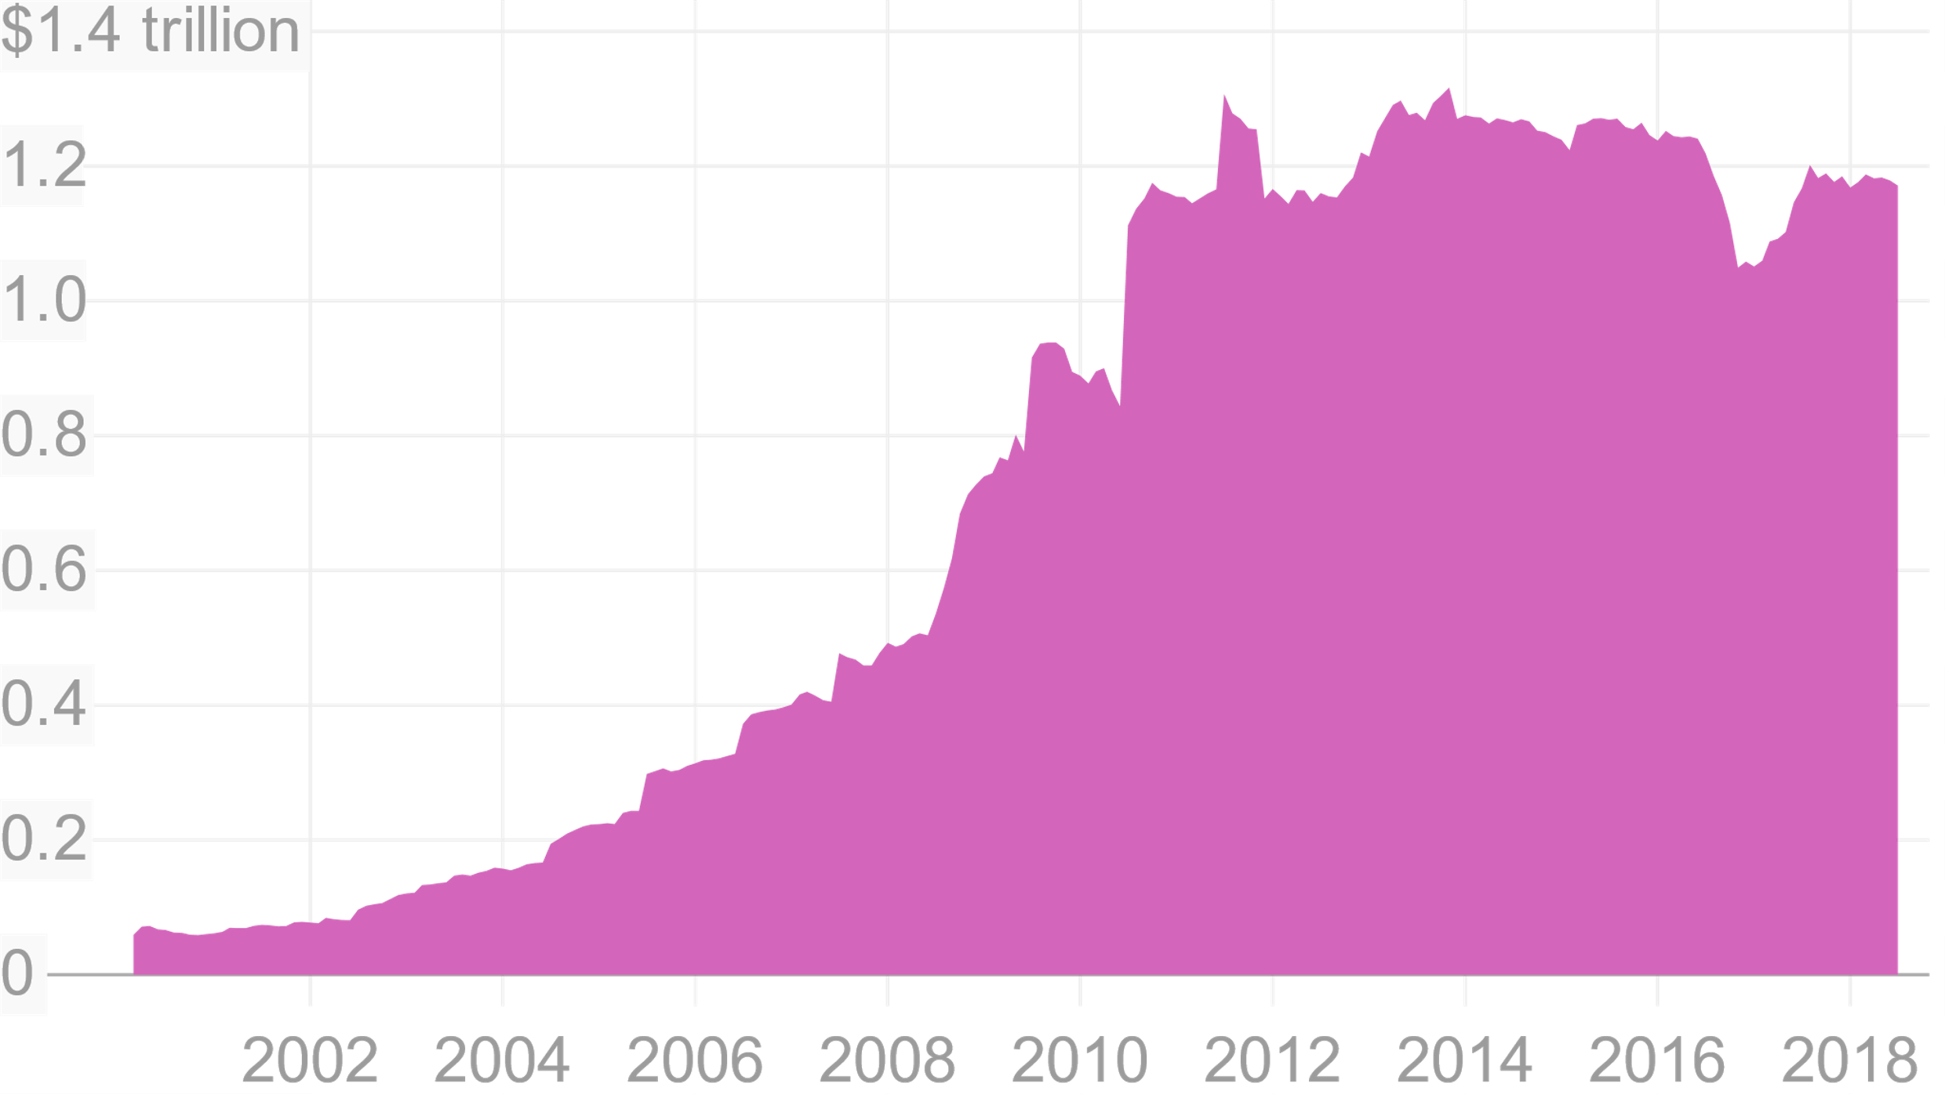
China’s Official Holdings of US Treasury securities
The “a nuclear option” is that the China is taking a step back from buying United States Treasuries and dumping what they own in the open market.
$1.4 trillion

Slide 11
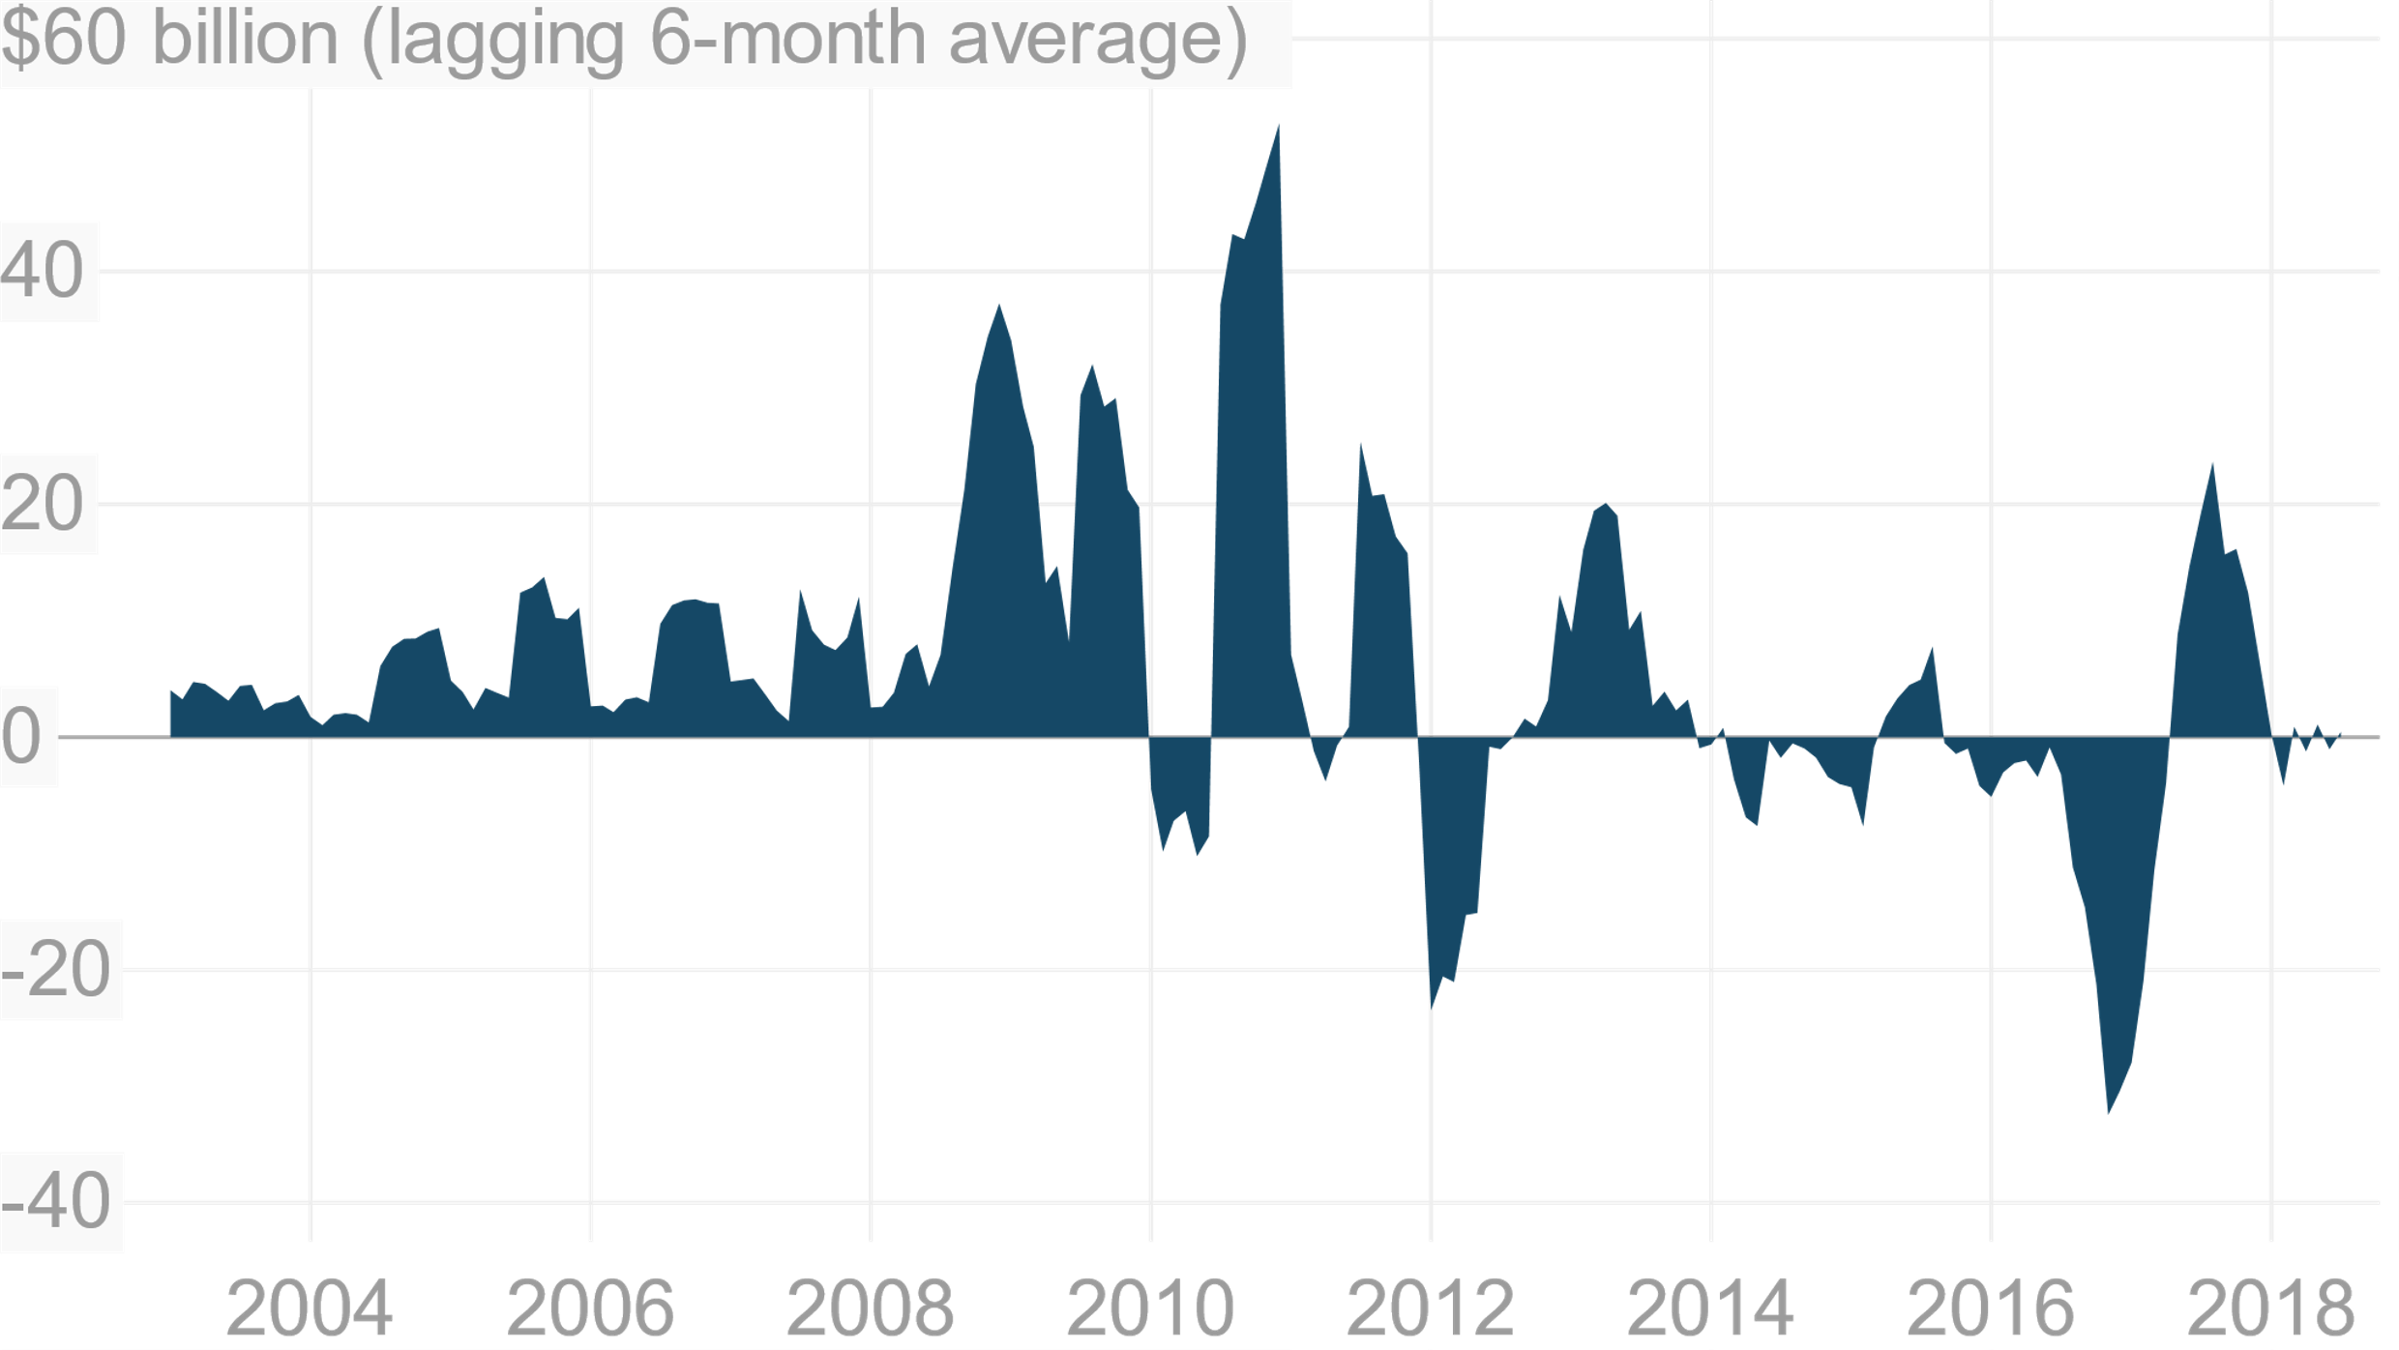
Net change in China's monthly holdings of The US Treasuries
$1.18 trillion
In fact, China made half of its Treasury purchases in 2011, and then throughout only the first half of 2016, sold off a lot of its holdings.
According to the U.S. Treasury, in April 2018, China owns an estimated $1.18 trillion in U.S. Treasuries, and they are the number-one investor among foreign governments.
$1.18 trillion is approximately 7.2 percent of the United States’ total debt load.
7.2% of the United States’ total debt
2018

Slide 12
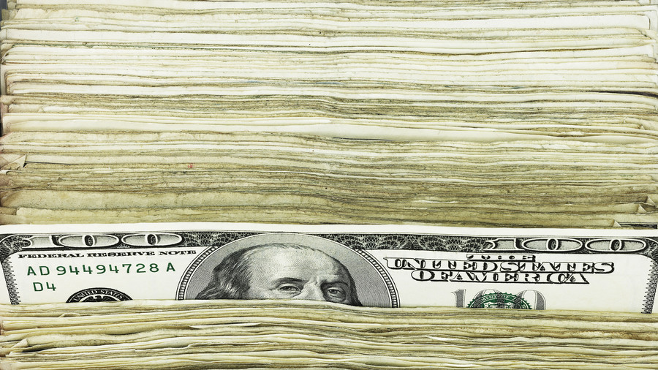
Russia to sell off more US Treasuries and buy more gold
According the US Treasury data, In 2010, Russia was among the top-10 holders of US debt at over $176 billion. With several rounds of US sanctions targeting the Russian economy since 2014, Russia began selling off its holdings to below $100 billion by October 2017.
Over the first six months of 2018, the Central Bank of Russia dumped 84 percent of its remaining holdings of US Treasury securities due to concerns about a wide range of risks, including financial, economic and geopolitical.
In May 2018, Russia’s holdings were just $14.9 billion, compared to $96.1 billion in March. At the same time Russia has added 106 tons of gold to its nearly 2,000-ton stockpile of its gold holdings. In fact, nearly two-thirds of Russia’s stocks of gold are held at the Central Bank’s repository in Moscow, shrouded in secrecy until recently. According to Komsomolskaya Pravda , there are ”rows and rows of containers with 20 gold bars between 12 and 13 kilograms apiece shown in a 17,000-square-meter warehouse.”
In 2018, Russia could make it into the top five gold-holding nations.

Slide 13
Will china and Russia use “a nuclear option” against the US?
No, it will not. It is highly unlikely that “nuclear option” will be used.
Here is why. Beijing needs to buy American debt in order to maintain its costs of having a trade surplus with America. By selling treasuries China would weaken the US dollar against the yuan which would decrease the US-China deficit, and slow the Chinese economic growth, then, as a result would make America the winner of this trade war.

Slide 14
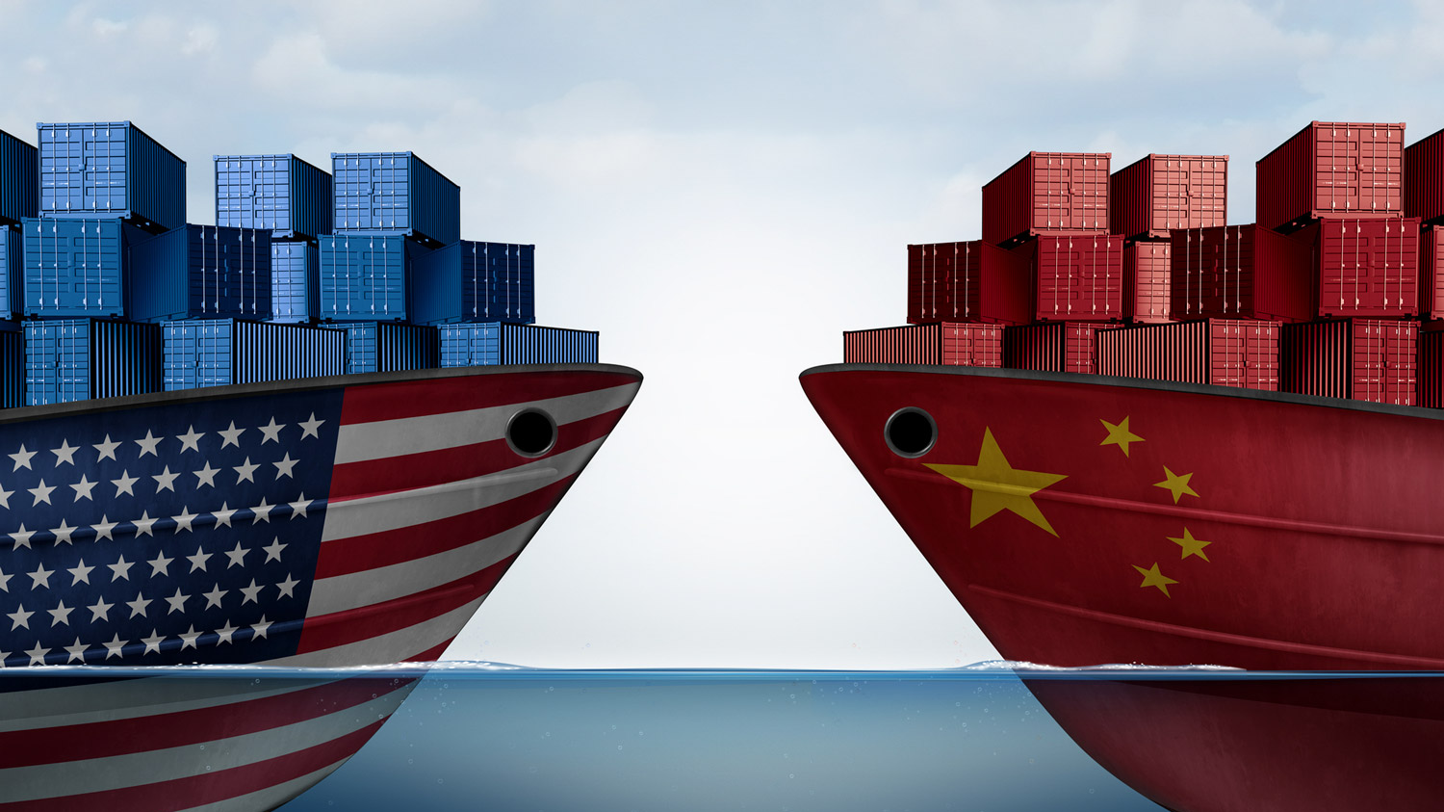
Conclusions
We can conclude that the US trade policy has shifted to protectionism. As a result, the international relations between America, China, Russia and other countries are facing big structural changes, and the question is what happens if the rules of the entire international trade are become different. New tariffs could be just one piece of that larger context of changes. These changes create a lot of fear of escalating the tensions between the US, China and Russia. There is a lot of speculation of possible scenarios for the Chinese–Russian retaliation. Perhaps, the “nuclear option” doesn’t happen to be one of these scenarios. Selling of US Treasuries appears to be not an effective policy, especially, in case of a trade war. However, the U.S. debt keeps growing larger, and this trade war could push debt even higher. Chinese-Russian cooperation in retaliation for the US tariffs and sanctions could continue to mature in 2018 and it will become even more sever in the near future. China and Russia have already started using gold-backed future contracts and pricing oil in yuan and rubles.
It’s hard to predict now how this trade war is going to turn out, who would be the winner or loser: America, China or Russia. Indeed, American consumers will be the losers who will pay for all negative impacts of new tariffs on the US economy. This new trade policy could lead not just to a collapse of the US dollar and a new recession, but to a new Cold War: this time with China and Russia, and this is what you need to know.

Slide 15
References
1. US Trade Deficit With China and Why It's So High
https://www.thebalance.com/u-s-china-trade-deficit-causes-effects-and-solutions-3306277
2. Russia Will Take China's Side Against U.S. in World Trade War
By Tom O'Connor https://www.newsweek.com/russia-will-take-china-side-against-us-world-trade-war-986417
3. The Unknowable Fallout of China’s Trade War Nuclear Option
By Andrew Ross Sorkin
https://www.nytimes.com/2018/10/09/business/dealbook/china-trade-war-nuclear-option.html
4. Russia to sell off more US Treasuries in retaliation against sanctions
https://www.rt.com/business/435817-russia-sell-us-treasuries-sanctions/
5. China’s “nuclear option” in the US trade war would be economic suicide
https://qz.com/1419180/chinas-nuclear-option-in-the-us-trade-war-would-be-economic-suicide/
6. A global trade war may produce a recession in the U.S., Stanford economist says
https://news.stanford.edu/2018/08/09/global-trade-war-may-produce-recession-u-s-economist-says/
7. Russia is Dumping Its US Bonds for Gold, But Where Is It Storing Its Bullion?
https://www.lewrockwell.com/2018/07/no_author/russia-is-dumping-its-us-bonds-for-gold-but-where-is-it-storing-its-bullion/

Slide 16
Thank you for your attention!
Questions?

